Slide 1
Math in Focus- A Clearer Picture for Parents
Presented by the 5th grade team (Shelley Hughes, Leigh Blumer, Marissa Benavidez) and Principal Greg Fairchild

Slide 2
Overview of the Evening
Why Math in Focus?
How does it work?
Think Central
Sample Problems
Questions

Slide 3
Why Math in Focus?

Slide 4
Why Math in Focus?
2011-2012 School Year
Committee formed to address the newly adopted Math Common Core State Standards (CCSS)
Gap Analysis with the assistance of Barb Wilmot- well known among Illinois educators
Several text book companies met with the textbook committee, who narrowed the search to two textbooks
Gathered input from all K-5 teachers
Math in Focus was clearly the right choice
A group of teachers and administrators attended a Math in Focus conference the summer prior to the adoption of the new textbook
Continued training

Slide 5
How Math in Focus Works
A parent overview from the makers of Math in Focus.

Slide 6
How Math in Focus Works
The Math in Focus program consists of Student Books and Workbooks that are designed to work together. During the school day, your child will learn concepts presented in an engaging format and practice those concepts to develop a deep understanding. Your child will also work from the Student Book with other children to solve problems, participate in activities or games, and discuss their ﬁndings in class.
Marshall Cavendish International (2009). Welcome Letter, School-to-Home Connections. Singapore.

Slide 7
How Math in Focus Works
Your child will be assigned pages from the Workbook as individual work in class or as homework. Assignments in the Workbook will include:
Practice problems to help reinforce the math skills or concepts
Put on Your Thinking Cap!
Challenging Practice problems which will broaden your child’s thinking skills and extend their understanding
Problem Solving questions that challenge your child to use relevant problem-solving strategies for non-routine problems.
Marshall Cavendish International (2009). Welcome Letter, School-to-Home Connections. Singapore.

Slide 8
How Math in Focus Works
Math in Focus addresses topics in greater depth at each grade.
This year, your ﬁfth grader will focus on:
• Building problem-solving skills and strategies
• Multiplying and dividing with 2-digit numbers, fractions, mixed numbers, and decimals
• Solving equations and evaluating inequalities
•Finding area of a triangle, and surface area and volume of three dimensional shapes
• Using ratios and percents, and ﬁnding the probability of an event
• Applying properties of angles, triangles, and four-sided ﬁgures
Marshall Cavendish International (2009). Welcome Letter, School-to-Home Connections. Singapore.

Slide 9
Think Central
A web-based resource for students and parents

Slide 10
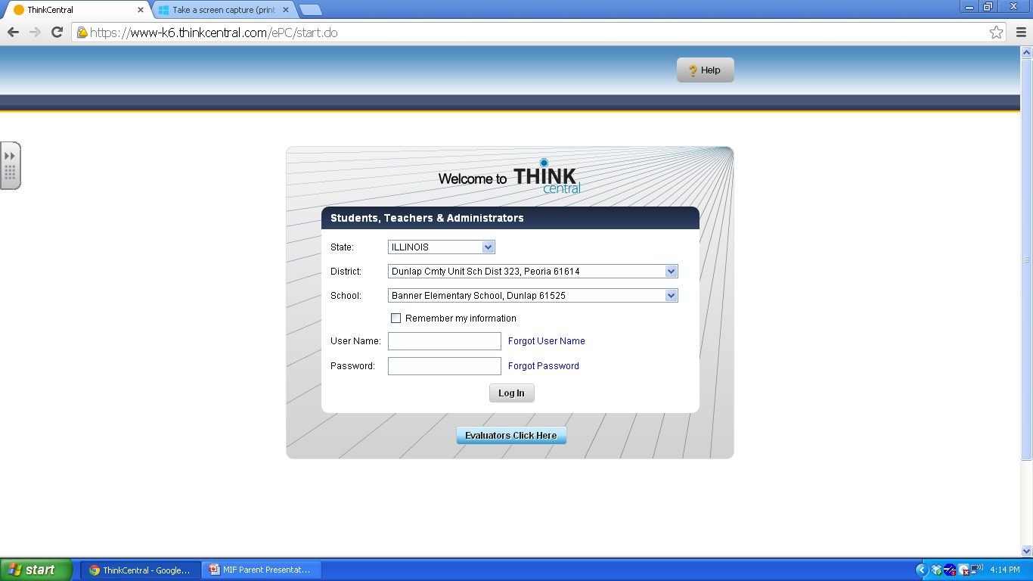
1. Scroll down to Illinois
2. Scroll down to choose Dunlap Cmty Unit Sch Dist 323, Peoria 61614
3. Scroll down to Banner Elementary School, Dunlap 61525
4. Type in your 6 letter username
5. Type in your 5 digit password

Slide 11
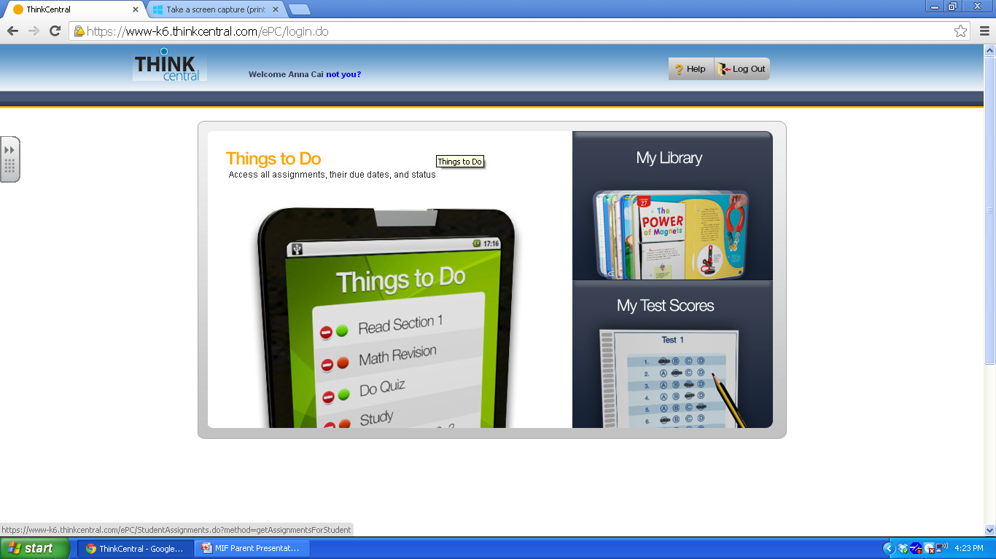
Click My Library to access math resources

Slide 12
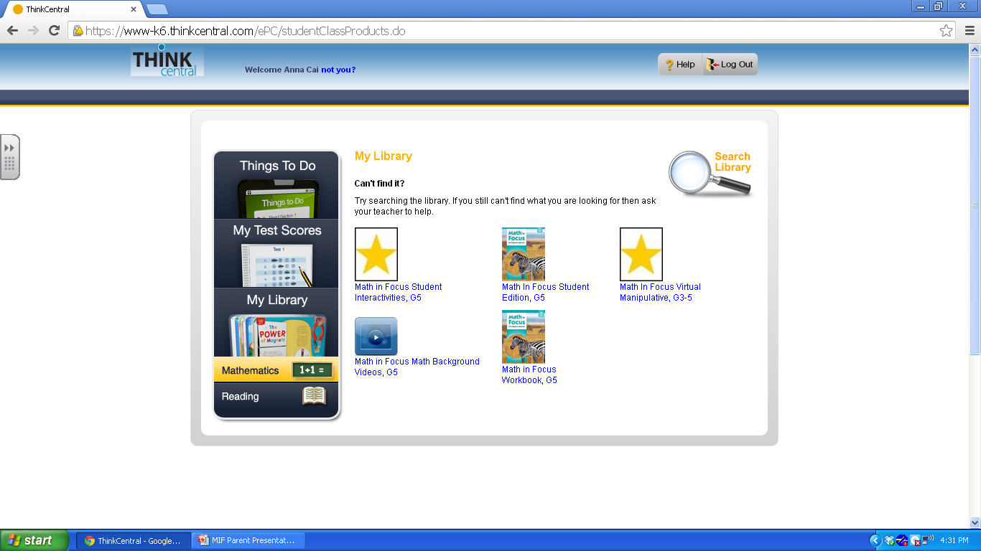
Virtual manipulatives allow you to make/use bar models, graphs, and other math tools.
Use this link for student friendly videos that reteach the lesson in a step by step format.
The student textbook so they do not have to bring it home each night.
This link provides overview videos for parents.
A copy of the student workbook if your child forgets their workbook at school.

Slide 13
Sample Problems
A chance to experience what your child experiences on a daily basis.

Slide 14
Sample from Lesson 2.7 Real-World Problems: Multiplication and Division (Part 1)
Mrs. Brandon had 230 soft toys. She kept 50 soft toys and distributed the rest equally to 15 children to sell for charity. Each toy was sold for $20. How much money did each child collect?

Slide 15
Lesson 3.7 Real-World Problems: Fractions and Mixed Numbers
In a day, Jamal spent 1 and 2/3 hours watching television, 1 and 4/5 hours taking an afternoon nap, and 7/8 hour helping his mother with housework.
How much time did Jamal spend on watching television and helping with housework?
How much more time did Jamal spend taking the nap than helping with housework?

Slide 16
Lesson 4.2 Real-World Problems: Multiplication with Proper Fractions
Tony is given 9/10 hour to mow a lawn. He only uses 2/3 of the given time to mow the lawn. How much time is left?

Slide 17
Lesson 4.5 Real-World Problems: Multiplication with Mixed Numbers
Lily uses 1 and 3 /4 meters of ribbon to make a knot. She wants to make 9 similar knots for her cousins. How many meters of ribbon does Lily need? Round your answer to the nearest meter.

Slide 18
Lesson 4.7 Real-World Problems: Multiplication and Division with Fractions
Devi and her brother had the same amount of money. After Devi spent 2/5 of her money and her brother spent 3 /10 of his money, they had $78 left altogether. How much did they spend altogether?

Slide 19
Lesson 5.1 Using Letters as Numbers
Alyssa has 6p dollars. Her brother has 15 dollars. How much more money does Alyssa have than her brother?

Slide 20
Questions
Anything we can answer?

